Slide 1

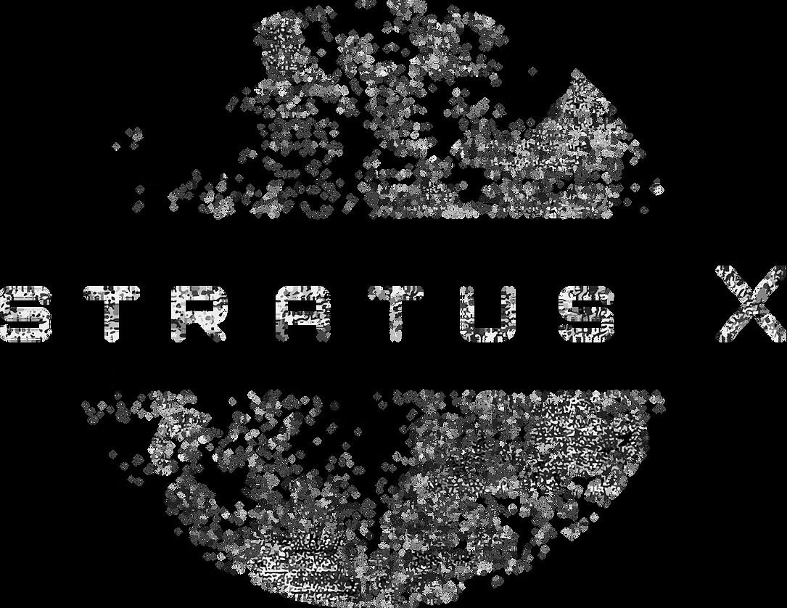

LPI/LPD in Contested
Commercial Cellular Networks
Obscuring behavior before it’s weaponized
Notes:
Good afternoon, I’m Raviv Laor., CEO of StratusX. This is my first time presenting at MILCOM, so if I miss a formalities or terms of art, I’ll ask in advance for your indulgence.
My background is in secure IP communications and telecom infrastructure, and our work at StratusX sits right at the edge of those two worlds.
The focus isn’t on content security but on the observables that betray identity, location, intent, and tempo.
And I’ll show you how we’ve built and fielded a capability that makes those observables disappear.
What I’ll share today is how we’ve taken a familiar doctrine - LPI/LPD - and applied it to commercial cellular environments.
Our thesis is that in light of communciations advancements we need a doctrinal update:
For decades we treated metadata as incidental telemetry.
That era is over.
Metadata is now an operational domain because it reveals behavior, maps people - their associations and logistics, and enables follow-on action.
Today I’ll make the case for a doctrine that accepts observability as unavoidable and responds by managing, corrupting, and operationalizing uncertainty.
Not invisibility.
Rather, A doctrinal posture that buys decision space, protects people, and changes (manipulates) adversary calculus.

Slide 2

The Metadata Explosion
Historical Metadata Evolution:
1990s: Call Detail Records (CDRs)
2000s: Digital advertising
2010s: Smartphones etc.
2020s: Always-on sensors, biometric data, real-time everything
"Metadata absolutely tells you everything about somebody's life. If you have enough metadata you don't really need content." - Former NSA General Counsel Stewart Baker
Notes:
The quantity of metadata has exploded exponentially over decades. In the 1990s, Call Detail Records painted powerful pictures of behavior and associations with just who called whom and when.
The oghts marked the scale transformation - internet advertising took what direct marketing companies had pioneered with demographics – from warranty registrations and credit records and the like; and applied it in real time at global scale. What started as operational telemetry became the core monetization of the digital economy, creating institutional incentives to collect and analyze metadata at massive scale.
Yet, somehow we were told metadata was just "digital exhaust" - a misleading characterization that obscured its actual strategic and economic value.
Today, everyone carries a comprehensive surveillance device generating continuous location, consumption, interaction, and biometric metadata streams 24/7.
Bruce Schneier quotes former NSA General Counsel Stewart Baker: "Metadata absolutely tells you everything about somebody's life. If you have enough metadata you don't really need content."
The "exhaust" became the engine.
But here's the critical insight that cybersecurity has missed: this metadata explosion didn't just create targeting opportunities for adversaries - it became the foundation of our entire defensive cybersecurity stack.
The military's massive shift to Zero Trust architecture makes this dependency even more acute. Zero Trust's "never trust, always verify" principle requires continuous monitoring and analysis of user behavior, device characteristics, network traffic patterns, and authentication metadata. Every verification decision depends on metadata analysis. Endpoint detection relies on behavioral metadata to identify anomalies. Network monitoring depends on traffic metadata to spot threats. Identity management systems track authentication metadata patterns. Threat intelligence correlates attack metadata signatures.
We built our defenses - including Zero Trust - on the same substrate that enables adversarial targeting. The observability required for security is identical to the observability that creates the behavioral attack plane.
Traditional cybersecurity focused on the content plane - protecting what you say. But Bruce Schneier's axiom that "amateurs hack systems, professionals hack people" now extends to: professionals hack behavior - both system behavior and human behavior - because in days when metadata was not so plentiful or readily available or cross-correlatable, systems revealed very little of themselves through behavior. Modern adversaries operate on the behavioral plane - exploiting who you are, where you are, when you communicate, and how you operate.
As of a year or two ago, this was a containable problem when metadata analysis required nation-state resources and specialized expertise. But that constraint no longer exists.

Slide 3
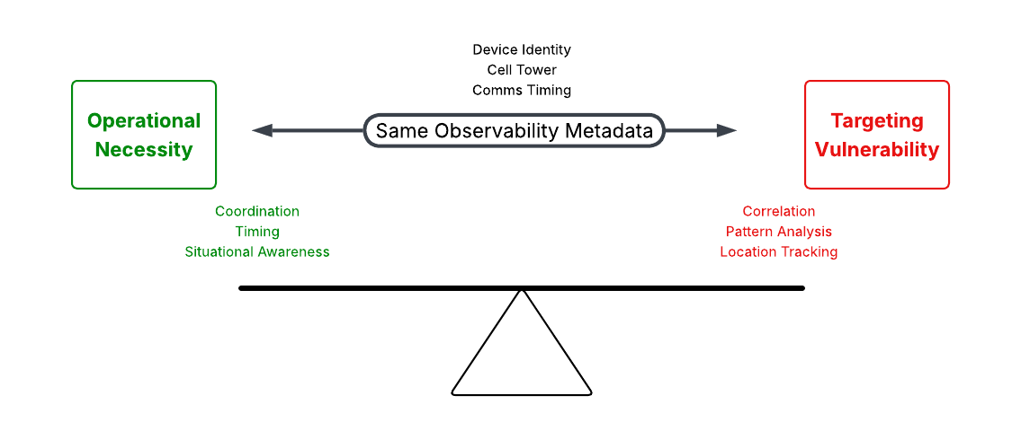
The Observability Paradox
Observability = Targeting data
Notes:
We face a fundamental observability paradox in military communications - indeed, in all communications and in the entire cybersecurity stack.
Every system we monitor for operational necessity generates the very metadata that enables adversarial targeting.
This applies to endpoint detection, network monitoring, identity management, threat intelligence, and every cybersecurity function.
The observability required for security is identical to the observability that creates attack surface.
The blindspot in traditional cybersecurity is assuming you can have operational observability without adversarial observability.
This is the fundamental paradox that traditional cybersecurity approaches cannot resolve

Slide 4
AI Weaponizes Metadata
Before AI: Metadata analysis required nation-state resources and expertise
Since AI: Any adversary can access resources for real-time targeting at unprecedented scale, scope, and precision
Real-World Examples (Open Source Reporting):
Senior IRGC commander (2020): Tracked through cellular metadata → drone strike
Ukrainian Officers (2022-present): Russian forces hunting commanders through device signatures
Mexican Cartels (2023): Using SS7 access for real-time personal geolocation
The Transformation: What killed Soleimani is now accessible to criminal organization
Notes:
And here's why that matters now: AI has weaponized this fundamental vulnerability..
AI has fundamentally democratized targeting capabilities that were once the exclusive province of nation-states:
The combination of commoditized AI access through cloud compute with open-source ML frameworks like TensorFlow, vast metadata availability through both commercial datasets and from illicit sources like Salt Typhoon,
and democratized analysis capabilities means any motivated adversary can now perform behavioral plane targeting operations that previously required extensive intelligence agency resources.
The perfect storm: massive metadata generation and availability, AI-powered pattern recognition at scale, and adversaries who understand that the behavioral plane is now more valuable than the content plane.
Qasem Soleimani was tracked and killed through cellular metadata analysis that would have taken intelligence agencies weeks to complete manually.
Russian forces are systematically hunting Ukrainian commanders through device signatures with near real-time analysis capabilities.
Mexican cartels are using SS7 access to geolocate executives and journalists with immediate results.
The critical shift is that targeting capabilities that killed a major military target are now accessible to criminal organizations and other non-state actors.
What took nation-state resources has, in a few short years, become available to anyone with motivation and a credit card.

Slide 5
Limitations of Current Doctrine in Dense Networks
Zero Trust, SD-WAN and Encryption: Secure only the content plane
Traditional LPI/LPD Doctrine: Designed for sparse, military-controlled RF environments
Dense Commercial Reality:
Transmission occurrence meaningless (thousands transmitting constantly)
Military forces don't control infrastructure or metadata-generating protocols
Attribution becomes the vulnerability, not transmission detection
Current Gap: Doctrine assumes we control the air. In LTE/5G, the air belongs to commercial networks like AT&T, Verizon equivalents, Huawei towers
The Reality: Our doctrine still treats metadata as exhaust. The adversary treats it as fuel.
Notes:
Zero Trust and encryption are - basic hygiene that secures the content plane but doesn't address the behavioral plane where the real targeting happens.
Traditional LPI/LPD doctrine was designed for sparse, military-controlled RF environments where detection of any transmission provides significant intelligence.
Attribution challenges existed in these environments, but the constrained setting with known participants and controlled infrastructure made the attribution problem manageable compared to today's reality.
In dense commercial cellular environments, this paradigm breaks down completely.
Transmission occurrence becomes meaningless when thousands of devices transmit constantly. While we've secured what we say through ZT & encryption, we've left completely exposed who we are, where we are, when we communicate, and how we operate - the behavioral plane that modern adversaries actually target.

Slide 6

You can't encrypt your way out of being watched
Notes:
This is the fundamental limitation that cybersecurity has missed. ZT, encryption protects what you say, but it doesn't protect who you are, where you are, when you communicate, or how you operate. The behavioral plane remains completely exposed.
Traditional approaches - whether LPI/LPD doctrine, Zero Trust, or encryption - all operate within the same infrastructure that generates the metadata vulnerability. They secure the content plane while leaving the behavioral plane wide open for adversarial targeting. None of them address the fundamental paradox: you cannot eliminate the observability required for targeting without also eliminating the observability required for operations.
So what's the alternative?

Slide 7
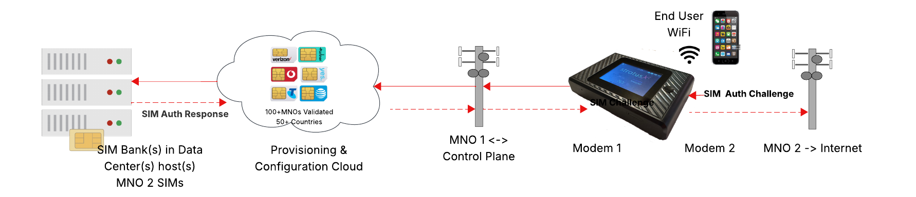
StratusX: Meta-Network Above Carriers
Architectural Approach: A meta-network that operates above and leverages existing commercial carrier infrastructure
Core Innovation: StratusX assumes the carrier's provisioning role
Critical Advantage: Independent of carrier integration - operates indistinguishably from normal traffic within their frameworks
Result: A global military meta-network using commercial infrastructure without particular relationships or dependencies
Notes:
The answer isn't trying to eliminate metadata generation - that's impossible without eliminating operational capability.
The answer is controlling who can observe and correlate that metadata.
StratusX solves the observability paradox through provisioning disintermediation - taking control of the metadata generation process itself.
The fundamental innovation is assuming the carrier's provisioning function without integration.
Physical SIM banks containing thousands of carrier-provisioned SIMs are housed in data centers under military control in the USA. The Kubernetes-based orchestration cloud dynamically allocates these ICCIDs to operational gateways based on mission requirements.
When a gateway requests cellular service anywhere on the planet, authentication challenges are proxied to the appropriate physical SIM in the remote banks.
From the carriers’ perspective, it sees a legitimate authentication from provisioned gateways/subscribers and have no visibility into actual operational processes, users, or even that StratusX infrastructure exists.
Adversaries would need to compromise physical SIM bank(s) under military control in the USA to disrupt operations globally. This architectural separation provides global operational capability with centralized security control.
This isn't just another security layer - it's a fundamental architectural approach that works within the constraints of the observability paradox rather than trying to eliminate it.
We control who can observe the metadata, not whether the observability exists.

Slide 8
Portable Identity-Mediating Gateway
Functions as gateway, router, and Wi-Fi access point in one device
End-user devices connect locally over Wi-Fi/Ethernet - never directly to the carrier
All carrier authentication proxied via remote SIM banks under secure custody
IMSI / ICCID / IMEI rotated before any exposure to the network
DNS and traffic proxying enforce metadata camouflage
Net effect: Carrier sees managed, ephemeral identities rather than persistent device fingerprints
Notes:
This box is all three - a gateway, a router, and a Wi-Fi access point. The key difference is that it mediates identity. End-user devices connect through it as if it were a normal router, but the carrier never sees their raw identifiers. Authentication is proxied through SIM banks under our custody, identifiers are rotated before exposure, and DNS/traffic are proxied. To the carrier, and to any adversary watching the network, what shows up is an ephemeral managed identity - not a persistent device fingerprint.
That’s how we break attribution at the root.

Slide 9

Multi Layer Metadata Exposure Mitigation Framework
RESULT
Reduced attribution confidence across layers
Enhanced Controls
LAYER 3
Protocol Camouflage (in development)
Managed TLS/QUIC fingerprint profiles
DNS behavior obfuscation (operational)
Noise/jitter variation
Synthetic pattern injection
Identity Management
LAYER 2
Identity Control
Dynamic SIM allocation from SIM banks in remote data centers
IMSI/IMEI rotation
Foundation
LAYER 1
RF Control
Cell frequency lock override
Signal strength manipulation (in development)
PLMN selection control
Location triangulation disruption
Notes:
The metadata camouflage stack provides layered control over every aspect of cellular interaction.
Layer 1 handles RF control as the foundation - including cell/frequency lock override, signal strength manipulation, network selection control, and location triangulation disruption, with additional capabilities like noise injection and timing jitter under development.
Layer 2 builds on this with identity control through dynamic SIM allocation from remote banks, with ICCID/IMEI rotation on network-dependent timing and authentication proxying to physical SIMs under military control.
Layer 3, currently in development, adds protocol camouflage through TLS/QUIC fingerprint randomization, DNS behavior obfuscation, traffic timing variation, and synthetic pattern injection.
This comprehensive approach ensures metadata camouflage across the entire cellular interaction stack, building from RF-level controls up through network identity management to application protocol obfuscation.

Slide 10
Fielded Capabilities vs. Validation Roadmap
Layer | Fielded Capability | Validation (in development)
Identity (IMSI / ICCID / IMEI) | Rotation demonstrated on live networks | Correlation linkage failure rates
RF (cell / frequency) | Lock & override validated | Detection latency testing
Protocol (DNS, TLS/QUIC) | DNS proxying fielded; TLS/QUIC in roadmap | Confidence decay & false positive metrics
Footer: Breakthrough complete. Remaining work = process engineering & validation.
Notes:
The breakthrough is already complete - we’ve severed provisioning from the carrier and demonstrated identity rotation, RF controls, and DNS proxying. What remains is process engineering: TLS/QUIC camouflage, synthetic traffic injection, and adversary-sim validation. These are engineering tasks, not scientific breakthroughs

Slide 11
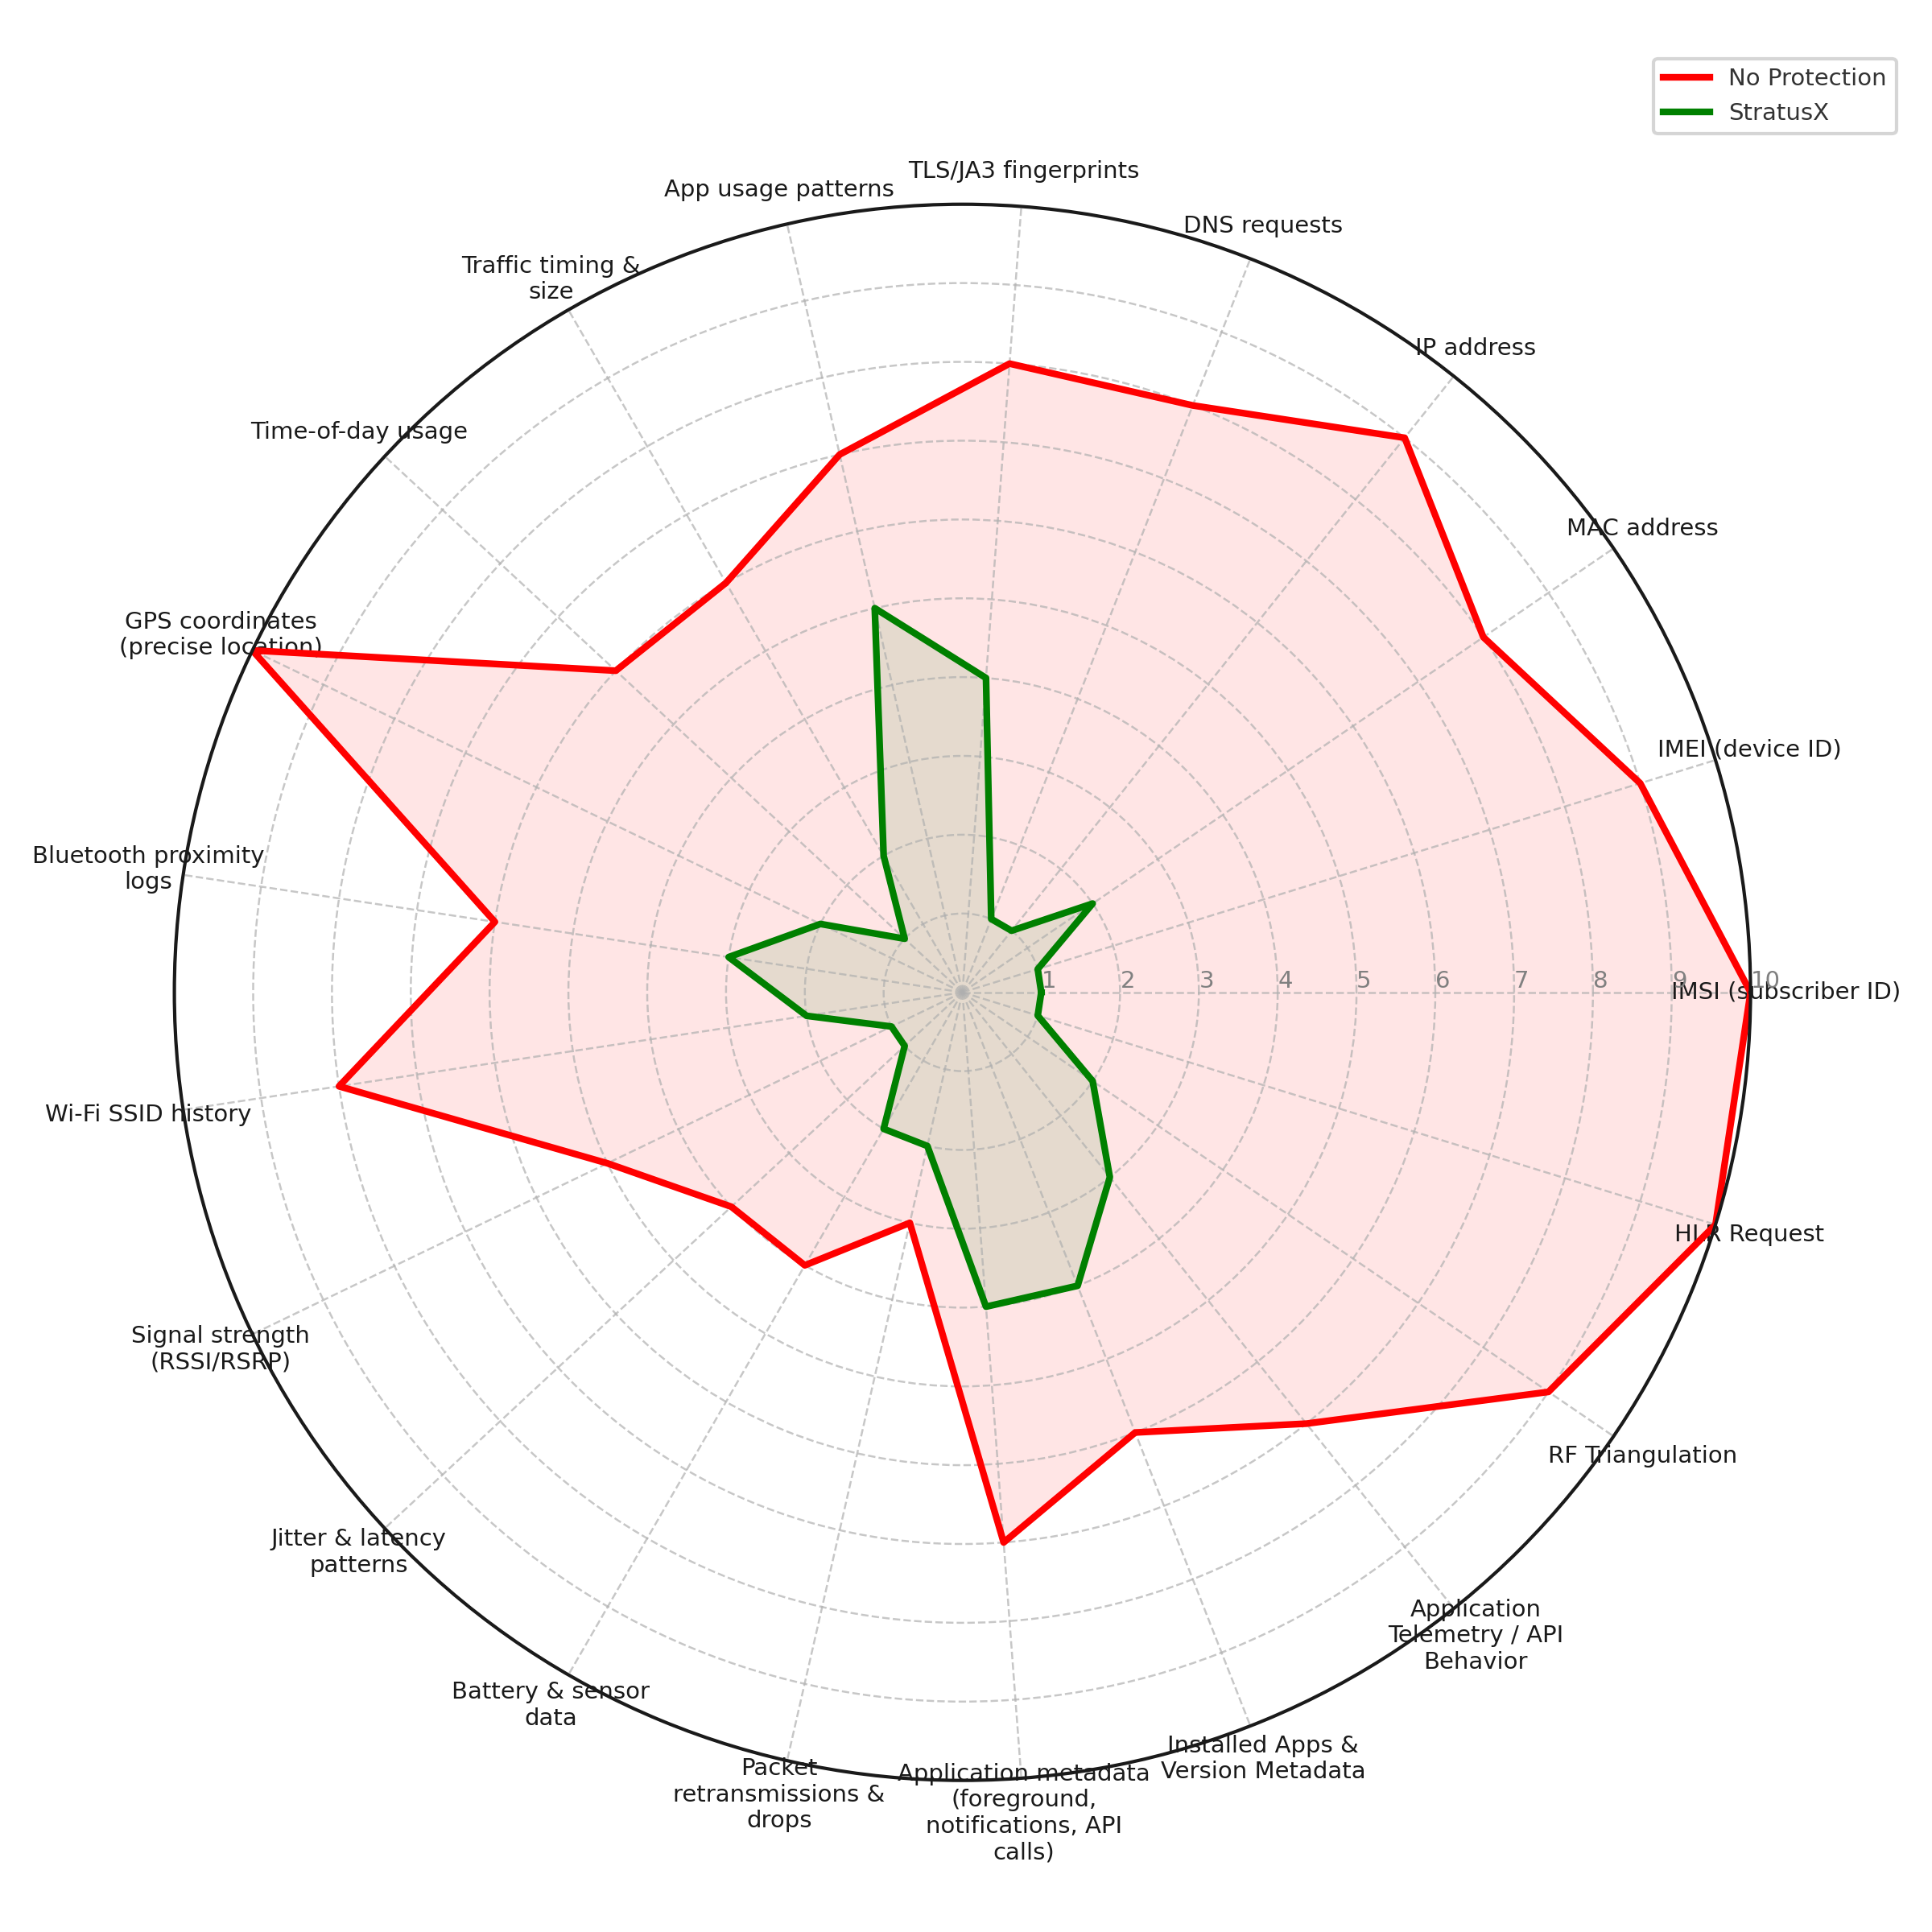
Quantifying LPI/LPD Attribution Certainty in LTE/5G Networks
Illustrative vulnerability scoring across attribution vectors:
Red line (Traditional): High attribution risk across key identity/location vectors.
Green line (StratusX) – Reduced adversary correlation confidence
Logical framework designed to show attribution vectors addressed by implemented capabilities. Quantitative validation of attribution reduction in development.
Notes:
This radar chart illustrates the behavioral exposure from a subset of metadata categories - comparing operation without protection versus using the current iteration of StratusX across key attribution vectors adversaries exploit for targeting.
The red line shows the stark reality: without protection, attribution is a certainty. Vulnerability scores of 8–10 across all vectors mean adversaries can confidently correlate, profile, and target. Device identities like IMSI and IMEI create persistent signatures that guarantee attribution. Location data from GPS coordinates and tower triangulation provides geolocation certainty. Network fingerprints, communication patterns, and application telemetry all reinforce attribution.
The green line demonstrates how StratusX transforms attribution certainty into attribution uncertainty.
Current capabilities reduce adversary confidence to 1–3 across vectors we already camouflage - identity, location triangulation, and core network behaviors.
Those elevated points on the chart are where protocol camouflage modules are still under development.
The goal is a perfect circle at score 1 - complete attribution uncertainty across all vectors. And before I show you how doctrine adapts to this, let’s ground this in field reality: what does an identity swap actually look like in time? How long does the system go dark while forcing that cold start?

Slide 12
Identity Swap Performance
(Hardware Dependent)
Environment | Observed Swap Duration | Cause / Notes
Urban EU/JP | 8–30s typical | Broad band coverage → fast reattach
General deployments | ~30s typical | Normal reattach behavior
Rural / sparse coverage | Up to 5 min (rare) | Limited band support → extended scan
Cold start / power-on | Longer than swap | Serial authentication of two SIMs during boot
Notes:
Swaps deliberately force a cold start. In dense networks, reattach is under 10 seconds; most environments are ~30 seconds; rural areas with band gaps can stretch to several minutes.
That variability is driven by hardware, not the system design.
One note: on cold startup, authentication takes longer because the device brings up two SIMs in sequence before traffic passes.
Once running, swaps behave as shown. With alternative dual-modem builds, we cut downtime to a few seconds while still forcing a fresh identity

Slide 13
LPI/LPD in LTE/5G is Attribution Control
Doctrinal Evolution: LPI/LPD has cycled between behavioral and content protection for 80 years - returning to behavioral focus - near-peers exploit prioritization of content plane security
Doctrinal Axiom: LPI/LPD approach is a function of RF environment density
Sparse RF Environments: Emission control effective - any transmission provides intelligence
Dense RF (LTE/5G) Environments: Attribution control necessary - transmission occurrence meaningless
Military Recognition: DoD implicitly acknowledges the behavioral plane vulnerability and seeks solutions
Traditional Doctrine: Designed for sparse, military-controlled environments
Commercial Reality: Dense networks require attribution-focused approaches
Notes:
This represents attribution control as the new paradigm for LPI/LPD doctrine
What makes this fundamentally "new" rather than simply returning to historical approaches is the shift from detection-based to attribution-based threats.
Traditional LPI/LPD focused on preventing detection because in sparse RF environments, any detected transmission provided actionable intelligence.
But In dense commercial cellular environments, detection becomes irrelevant - thousands of devices transmit constantly, so adversaries can't and don't need to prevent all transmissions.
Instead, they focus on attribution - linking specific transmissions to specific users for targeting.
The doctrinal shift is from "don't let them detect you're transmitting" to "don't let them know it's you transmitting." This fundamental change in the threat model requires new approaches optimized for attribution control rather than emission control.
LPI/LPD doctrine has cycled between behavioral and content protection for 80 years - from WWII frequency hopping through Cold War emission control, to digital-era encryption emphasis, and now back to behavioral focus as near-peer threats exploit our prioritization of content plane security.
But this current shift represents environmental adaptation, not just cyclical return.
The military has implicitly acknowledged this behavioral plane vulnerability through multiple programs. DARPA's Protected Forward Communications program explicitly focuses on defeating adversary electronic warfare kill chains through behavioral measures rather than just strengthening encryption.
StratusX represents this doctrinal evolution - attribution control optimized for dense commercial environments where traditional emission control assumptions no longer apply. The military has identified the problem through multiple initiatives. We're providing the architectural solution.

Slide 14
Deployment Status
Proven (Fielded & Validated)
Engineering Pipeline
2,000+ gateways manufactured, FCC-certified
SIM bank/cloud infrastructure live >3 years (continuous operation)
Validated on 100+ commercial carrier networks worldwide (visual matches logos)
ICCID/IMSI/IMEI rotation demonstrated on live LTE/5G networks
DNS proxying & RF/cell-lock controls fielded
TLS/QUIC fingerprint randomization (software hardening)
Synthetic traffic injection (validation in progress)
Adversary-sim correlation metrics (planned validation)
Expanded modem band support (hardware integration option)
Notes:
This isn’t theory.
Over 2,000 gateways are already manufactured and FCC-certified.
The SIM bank infrastructure has been running continuously for over three years. We’ve validated across more than a hundred commercial networks worldwide.
What’s already fielded includes ICCID/IMEI rotation, DNS proxying, and RF controls. That’s the breakthrough, separating provisioning from the operator and forcing cold-start identities.
And it’s already fielded: IICCID/IMEI rotation, DNS proxying, and RF controls.
What remains is process engineering:
TLS/QUIC camouflage,
synthetic traffic injection,
adversary-sim validation,
and expanded band support.
No new science is required.

Slide 15
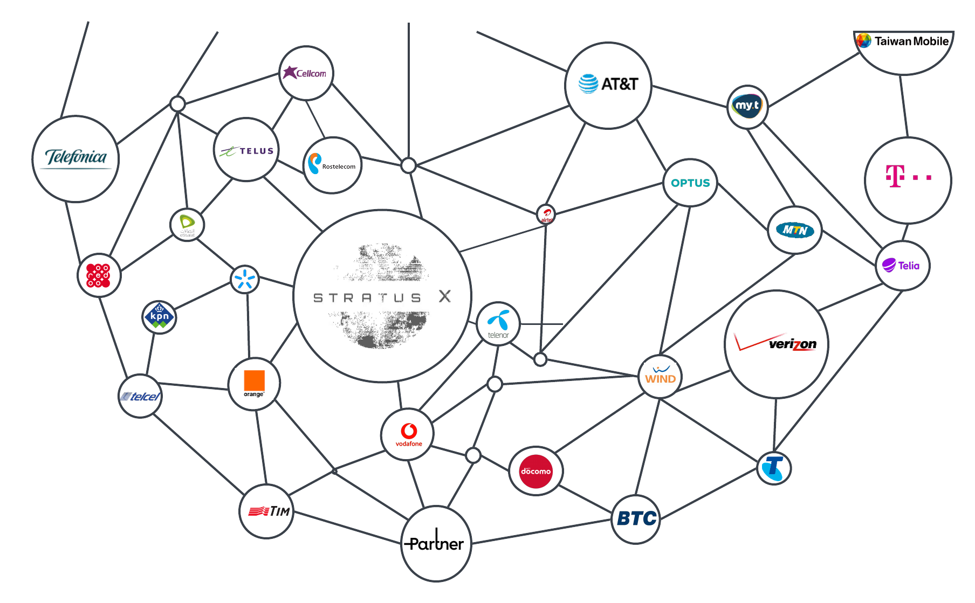
THANK YOU
Encryption is table stakes. The next fight is metadata camouflage
Technical Demonstrations Available Table [X]:
Q&A
Notes:
I’ll close here. What you see in this graphic is the leveraging of commercial network infrastructure to maintain LPI/LPD for people and systems. StratusX provides a global orchestration layer above commercial carriers that delivers true communications camouflage.
Come see the solution in operation. Our team includes systems architects, network security researchers, and operational engineers ready for technical discussions, validation planning, and transition pathways

